Slide 1

Valour Multi Academy Trust
Schools working in Partnership
Schools working in progressive partnerships to empower educators and affect change.

Slide 2
GLOSSARY
IEF | Improvement Evaluation Framework | Self- evaluation process, completed alongside leadership team using evidence to support decision making
S&C | Support and Challenge | Structured meeting with targeted questions from *** that will support next steps, research opportunities, and support options
VA | Valour Associate | Team working with HTs to evaluate schools
IST | Intensive Support Team | Central Team, CEO and SDPs

Slide 3




SCHOOL IMPROVEMENT PHASES 2023-24
INADEQUATE
STABILISE AND
REPAIR
REQUIRES
IMPROVEMENT
IMPROVE **
GOOD
SUSTAIN AND
INNOVATE
OUTSTANDING
LEAD OTHERS
School supported to achieve
significant improvements
Clear systems will be designed and implemented
Capacity built for long term stability.
Decision making will be proactive
Quickly establishing stability
Schools will be more
functional
Outcomes will improve
Proactive leadership developed across the school
Strategies embedded and followed with fidelity
Increased innovation in ways of working
Sufficient strength/
capacity to support and lead others across schools and trusts.
Sharing good practice and whilst honing skills further within their own school
**RI schools can access funding from the DFE for 10 days of support which will be organised by Valour Trust.
Notes:
The initial support would be based on the latest OFSTED judgment which would be updated and supplemented by the IEF completed by the HT alongside a Valour Associate.

Slide 4





IMPROVEMENT FRAMEWORK TO GAUGE SUPPORT NEEDED BASED ON CURRENT OFSTED JUDGEMENTS-
SCHOOL EVALUATION WITH VALOUR ASSOCIATES FOR DISCUSSION
STABILISE AND REPAIR
Outcomes need rapid improvement
Curriculum design needs
Developing
Data analysis needs improving.
Behaviour is unstable
Low level disruption
Limited/ outdated Personal Development. Lack of
Opportunities
Wider leadership is unstable
Lack of leadership in EYFS
Provision is not appropriate for EYFS
IMPROVE
Data systems are used to target improvement.
Outcomes not yet at national average.
Behaviour is better but low level disruption continues and hinders progress
Personal development
curriculum is mapped against most aspects of SMSC, British Values and RSE
Stable leadership and increasing capacity
Systems in place for
monitoring
Leaders in place and
Developing
Provision is appropriate for some
INNOVATE
Pupil outcomes at or above national average and few pupil groups under perform
Curriculum intent, implementation and impact in place
Behaviour positive with few incidents of low level or disruptive behaviours
High quality support in place
PD curriculum intent, implementation and impact prepares pupils for life in modern Britain
Leadership is strong and improvements are embedded. Succession planning in place
Leadership of EYFS is strong
GLD data at or above
national average
LEAD
Exceptional pupil outcomes in all areas with capacity to support others curriculum intent is progressive and well sequenced.
Pupil behaviour is exceptional and there is capacity to lead and support other academies
PD curriculum is high quality, enriching provision for character development. Respect for others. Capacity and strength to support others.
Leadership strong. Highly effective strategic leadership with capacity to support others.
Outstanding EYFS leadership and practice with the capacity to support others.
Quality of Education
Behaviour and
attitudes
Personal
development
Leadership
EYFS

Slide 5
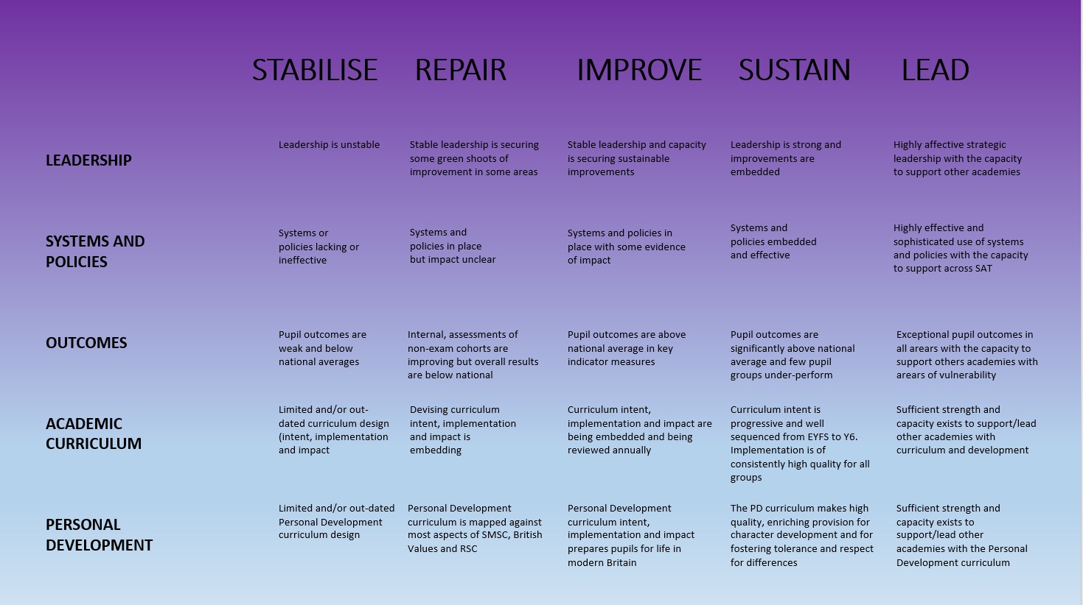




IMPROVEMENT EVALUATIONS FRAMEWORK USED ALONGSIDE LEADERSHIP TEAM
Notes:
This would not be for initial send out to schools however it will be used once we are working with school alongside the head to find strong practice as well as areas for development in all schools to foster positive relationships. It also needs some icons to ensure consistency across the system.

Slide 6
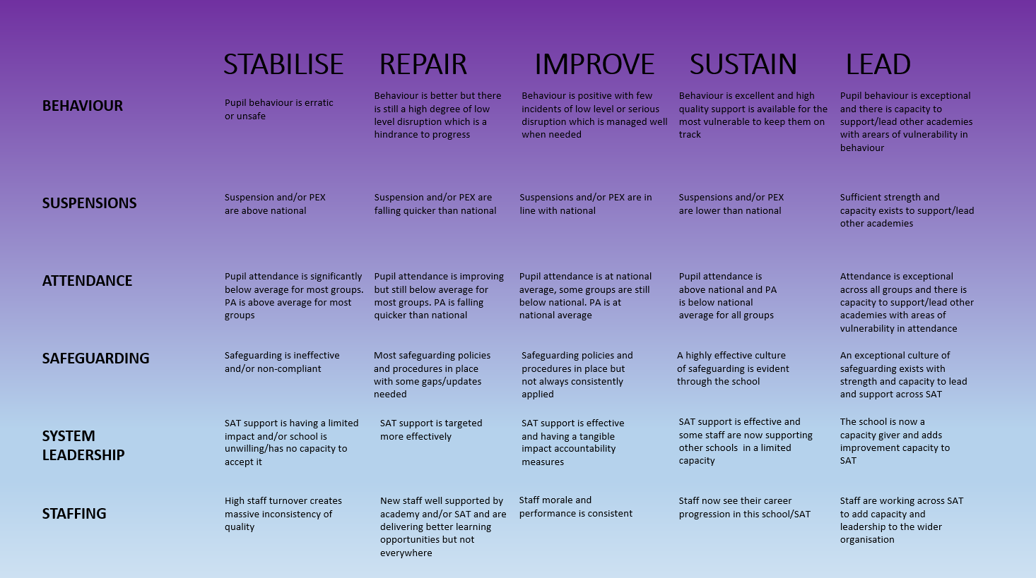





IMPROVEMENT FRAMEWORK TO GAUGE SUPPORT NEEDED BASED ON CURRENT OFSTED JUDGEMENTS-
SCHOOL EVALUATION WITH VALOUR ASSOCIATES FOR DISCUSSION

Slide 7
Example termly timetable of support.
Focused Planning meeting
Associate and HT termly actions
Meeting to review feedback on the term of work and impact
Complete IEF
Analyse actions from Ofsted with associate AFD
S&C meeting
HT, SLT and Valour Associate
Evaluation of support and next steps. Revisit IEF
Commence support to improve specific areas to secure Outstanding.
Evaluate initial
actions.
Cluster meeting of those supporting in other schools.
HT cluster- CPD
Notes:
This is an example of what a half termly support package would look like – this would depend on how long the school had been involved, and the level of need at that point. There are systems that are embedded in all levels of support.

Slide 8




Support and Challenge Meetings
Shared agreement
Review of actions/ impact/IEF
Commit to action plan
Broker/ agree support
SLT and SIT discuss proposed outcomes of the meeting and agree protocols. All members to be clear on what they want to achieve and how this will be measured.
Discuss and agree the outcomes of any actions from the previous meetings.
Review the IEF judgements to highlight strengths , improvements since the last meeting.
Subsequent meetings to include review of commissioned work and evaluation of impact.
Discuss current data – strengths and any gaps.
Support SLT to focus on specific area to develop.
Agree success criteria
Formulate action plan with time scales and specific actions/ activities
Decide on how support will be delivered. This can be visits to other schools, work within the school with subject lead, support from external leads etc.
Notes:
This is the overview of Support and Challenge meetings which would take place half termly or termly in all schools to ensure continuous improvement, depending on the level of support needed.

Slide 9




Head Teacher CPD Days
Update on work across the partnership.
CPD session
Sharing practice
Joint working opportunities
Discussion of research and areas of development happening across the school.
Chance to talk about current concerns.
Relevant input for HT development. This would come from needs across the partnership or research based training.
Opportunities to share resources and policies to look at other practice. Sharing teaching and learning approaches/ work in books
Arrange school visits, leader meetings and potential coaching.
Notes:
This is an overview of HT CPD days which would involve all head teachers – building networks, sharing good practice, and building a supportive network where HTs can be honest about their strengths and next steps.

Slide 10

Packages available to all schools
School Development Partner Package. 3 visits per year with a Valour Associate including 3 visits with report and Head Teacher Performance Management - £650 per visit **link to Valour Associate biogs
Subject audits/ reviews. Minimum of 3 per year - £350 per review day
HT CPD days focusing on current research and best practice. One per term – no cost with above packages
Research groups. Termly meetings to work in groups on common areas for development including school visits – no cost with above packages
For more information, please visit About Valour | Valour Multi Academy Trust (secure-primarysite.net) and click on Schools In Partnership.
To request support, please visit https://forms.gle/Udj4kDDqZwCgRUu28

Slide 11
Developing Subject Leads – opportunities for your leaders
Subject Audit Day
Subject Interest Day
Subject Deep Dive Day
Subject Leader Research Group
New to Subject Leadership Session
Curriculum Hours
For more information on subject leader development please visit
Link to subject leader development sessions on website
For more information, please visit https://www.valourmat.co.uk/
To request support, please visit https://forms.gle/Udj4kDDqZwCgRUu28

Slide 12




New to Subject Leadership Session
Partner work
Timeline
Support
Shadow
Opportunity to work with an experienced leader and create a strong partnership.
Timeline essential tasks of a subject leader across the year.
Understand importance and impact of actions.
Experienced leaders support with evaluations and actions including modelling. in their own, or your own school.
New leaders have the opportunity to have a leader in their own school or visit their partner's to observe and reflect on practice.
Notes:
This slide and the next are Walkthrus of 2 of the leadership support sessions we offer. These sessions would be led by leaders from good and outstanding schools to further develop them.

Slide 13




Curriculum Hours
Subject knowledge
Inclusion
Key threads and concepts
Links to other curriculum areas
CPD on key knowledge needed in a curriculum subject
Ensuring strong teacher knowledge
CPD around ensuring barriers to learning are removed so that all children can access the subject.
Mapping out the curriculum to ensure key threads and concepts are revisited through cyclical learning.
Planning out links to other curriculum areas to strengthen learning.

